Slide 1
Simulované žíhání - řešení Sudoku
EVO projekt 2023/24
Bc. Adam Hos

Slide 2
Úvod
Zkoumané téma – řešení sudoku pomocí Simulovaného žíhání
Nástroje - Python v3.10
py-sudoku
Numpy
Matplotlib
Záměr měření
Obtížnost sudoku
Penalizace konfliktu se zadáním
Teplota
Velikost

Slide 3
Implementace
Reprezentace sudoku
numpy.ndarray
Obtížnost : 0.5
OneHot:
+-------+-------+-------+
| | 1 1 1 | 1 1 |
| 1 | | 1 |
| 1 | 1 | 1 1 1 |
+-------+-------+-------+
| 1 1 | 1 1 | 1 1 |
| | 1 1 1 | |
| 1 1 | 1 | 1 1 |
+-------+-------+-------+
| 1 1 | 1 1 | 1 |
| 1 | 1 1 1 | 1 |
| 1 1 | 1 1 | 1 |
+-------+-------+-------+
Task:
+-------+-------+-------+
| | 5 9 6 | 1 3 |
| 5 | | 8 |
| 6 | 8 | 5 7 9 |
+-------+-------+-------+
| 1 6 | 8 2 | 3 7 |
| | 6 5 9 | |
| 8 9 | 3 | 6 5 |
+-------+-------+-------+
| 1 5 | 8 6 | 9 |
| 6 | 9 3 1 | 4 |
| 4 3 | 7 5 | 1 |
+-------+-------+-------+
Board:
+-------+-------+-------+
| 4 2 1 | | 2 |
| 3 8 | 2 3 1 | 4 6 |
| 7 9 | 4 7 | |
+-------+-------+-------+
| 5 | 7 | 8 |
| 4 2 7 | | 4 1 9 |
| 3 | 4 1 | 2 |
+-------+-------+-------+
| 8 | 2 | 3 6 |
| 9 7 | | 7 8 |
| 2 | 4 | 2 5 |
+-------+-------+-------+
Task + Board:
+-------+-------+-------+
| 4 2 1 | 5 9 6 | 1 2 3 |
| 3 8 5 | 2 3 1 | 4 8 6 |
| 7 6 9 | 4 7 8 | 5 7 9 |
+-------+-------+-------+
| 5 1 6 | 7 8 2 | 8 3 7 |
| 4 2 7 | 6 5 9 | 4 1 9 |
| 8 3 9 | 4 1 3 | 6 2 5 |
+-------+-------+-------+
| 1 5 8 | 8 6 2 | 3 9 6 |
| 6 9 7 | 9 3 1 | 7 8 4 |
| 2 4 3 | 4 7 5 | 2 5 1 |
+-------+-------+-------+

Slide 4
Implementace
Hodnotící funkce
Konflikty?
TaskXBoard váha = CONFLICT_WITH_TASK_CELL_COST
BoardXBoard váha = 1
Task:
+-------+-------+-------+
| | 5 9 6 | 1 3 |
| 5 | | 8 |
| 6 | 8 | 5 7 9 |
+-------+-------+-------+
| 1 6 | 8 2 | 3 7 |
| | 6 5 9 | |
| 8 9 | 3 | 6 5 |
+-------+-------+-------+
| 1 5 | 8 6 | 9 |
| 6 | 9 3 1 | 4 |
| 4 3 | 7 5 | 1 |
+-------+-------+-------+
Task + Board:
+-------+-------+-------+
| 4 2 9 | 5 9 6 | 1 2 3 |
| 3 8 5 | 2 3 1 | 4 8 6 |
| 7 6 1 | 4 7 8 | 5 7 9 |
+-------+-------+-------+
| 5 1 6 | 7 8 2 | 8 3 7 |
| 4 2 7 | 6 5 9 | 4 1 9 |
| 8 3 9 | 4 1 3 | 6 2 5 |
+-------+-------+-------+
| 1 5 8 | 8 6 2 | 3 9 6 |
| 6 9 7 | 9 3 1 | 7 8 4 |
| 2 4 3 | 4 7 5 | 2 5 1 |
+-------+-------+-------+
Board:
+-------+-------+-------+
| 4 2 9 | | 2 |
| 3 8 | 2 3 1 | 4 6 |
| 7 1 | 4 7 | |
+-------+-------+-------+
| 5 | 7 | 8 |
| 4 2 7 | | 4 1 9 |
| 3 | 4 1 | 2 |
+-------+-------+-------+
| 8 | 2 | 3 6 |
| 9 7 | | 7 8 |
| 2 | 4 | 2 5 |
+-------+-------+-------+

Slide 5
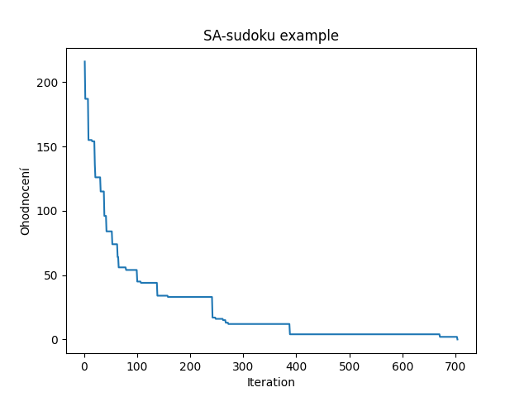
Implementace - ukázka
Nastavitelné hodnoty (z předešlé ukázky)
Graf iterace x ohodnocení
DIFFICULTY = 0.5
WIDTH = 3
HEIGHT = 3
ITER = 5000
CONFLICT_WITH_TASK_CELL_COST = 10
COOLING_TYPE = Geometric
TEMP_INITIAL = 6
TEMP_LOSS = 0.95
TEMP_REHEAT = 2
TEMP_LOW_THR = 0.5
TEST_COUNT = 30

Slide 6
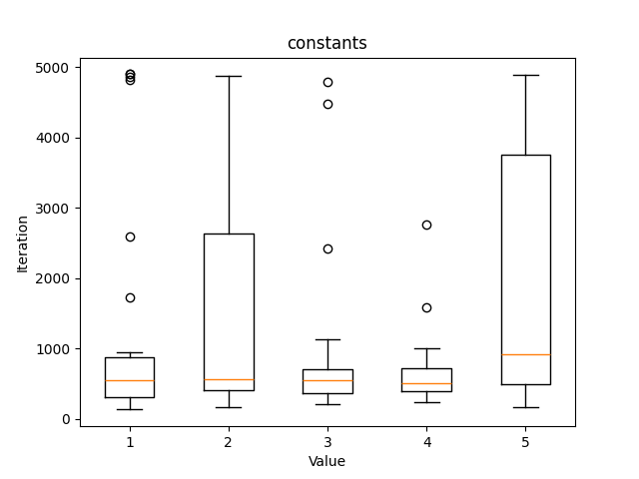
Měření
Konstantní měření pro několik běhů – ukázka variace
Pro 5 různých sudoku
Počet měření = 5
Graf iterace x ohodnocení
Konstanty
DIFFICULTY = 0.5
WIDTH = 3
HEIGHT = 3
ITER = 5000
CONFLICT_WITH_TASK_CELL_COST = 5
COOLING_TYPE = Geometric
TEMP_INITIAL = 6
TEMP_LOSS = 0.95
TEMP_REHEAT = 2
TEMP_LOW_THR = 0.5
TEST_COUNT = 30
Dále generováno pro každý běh uniká sudoku

Slide 7
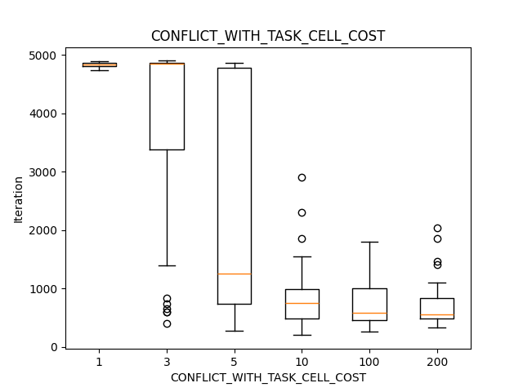
Měření
Graf iterace x ohodnocení
Měřené hodnoty
CONFLICT_WITH_TASK_CELL_COST
TEMP_INITIAL = CONFLICT_WITH_TASK_CELL_COST / 2
TEMP_REHEAT = TEMP_INITIAL / 4
Konstanty
DIFFICULTY = 0.5
WIDTH = 3
HEIGHT = 3
ITER = 5000
COOLING_TYPE = Geometric
TEMP_LOSS = 0.95
TEMP_LOW_THR = 0.5
TEST_COUNT = 30

Slide 8
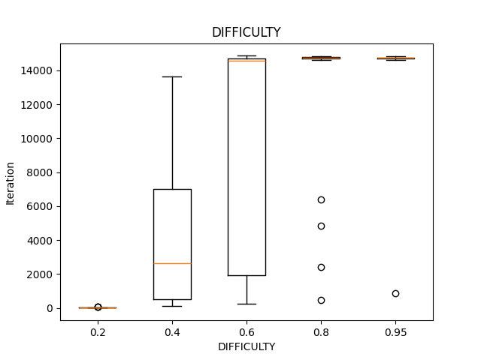
Měření
Graf iterace x ohodnocení
Měřené hodnoty
DIFFICULTY
Konstanty
WIDTH = 3
HEIGHT = 3
ITER = 15000
CONFLICT_WITH_TASK_CELL_COST = 10
COOLING_TYPE = Geometric
TEMP_INITIAL = 5
TEMP_LOSS = 0.95
TEMP_REHEAT = 2
TEMP_LOW_THR = 0.5
TEST_COUNT = 30

Slide 9
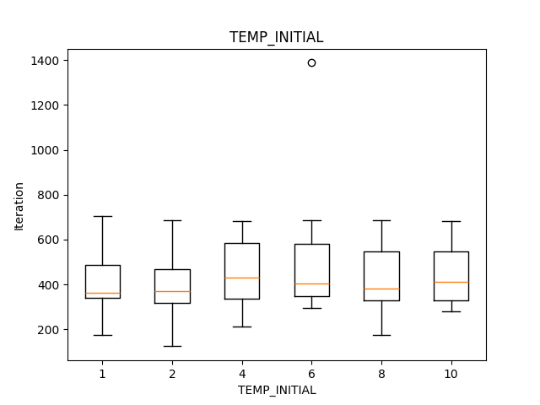
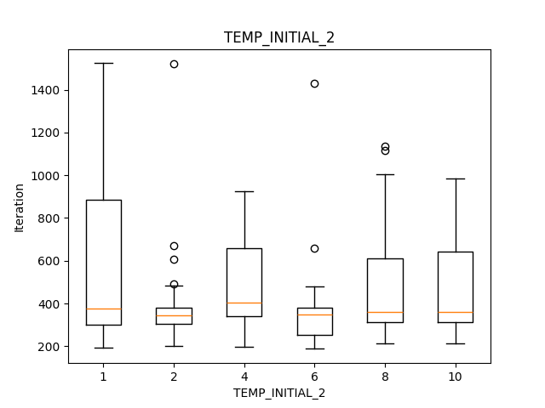
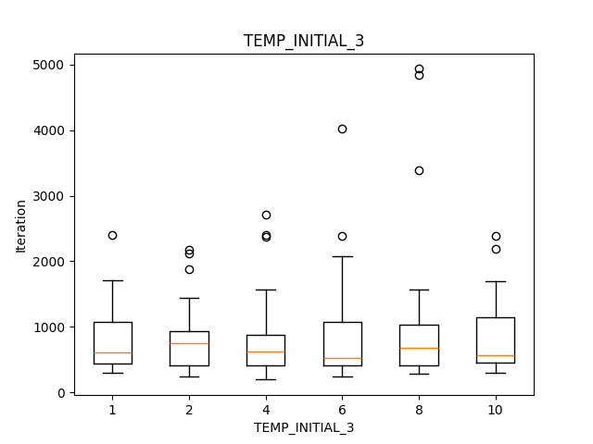
Měření
Graf iterace x ohodnocení
Geometrická teplota
Měřené hodnoty
TEMP_INITIAL
TEMP_LOSS = [0.95, 0.9, 0.99]
TEMP_REHEAT = TEMP_INITIAL / 4
Konstanty
DIFFICULTY = 0.5
WIDTH = 3
HEIGHT = 3
ITER = 5000
CONFLICT_WITH_TASK_CELL_COST = 10
COOLING_TYPE = Linear
TEMP_LOW_THR = 0.5
TEST_COUNT = 30
TEMP_LOSS = 0.95
TEMP_LOSS = 0.9
TEMP_LOSS = 0.99

Slide 10
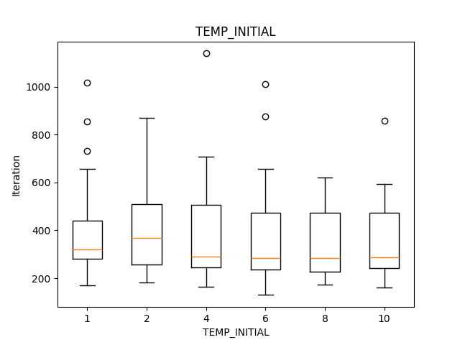
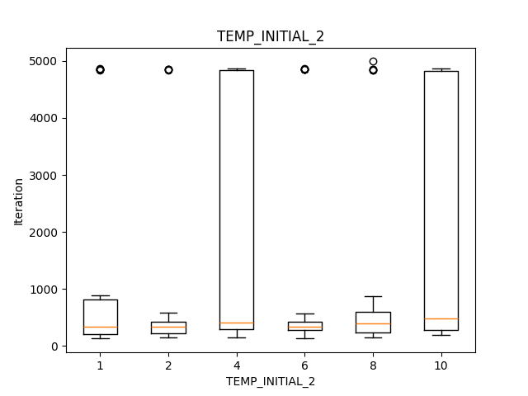
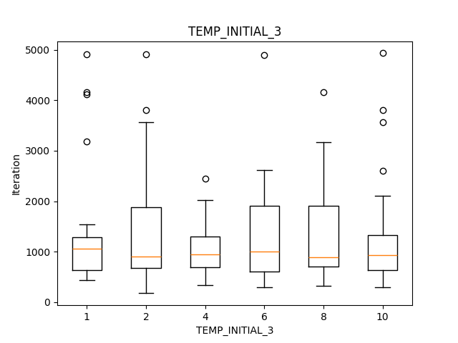
Měření
Graf iterace x ohodnocení
Lineární teplota
Měřené hodnoty
TEMP_INITIAL
TEMP_LOSS = [0.1,0.5,0.2]
TEMP_REHEAT = TEMP_INITIAL/ 4
Konstanty
DIFFICULTY = 0.5
WIDTH = 3
HEIGHT = 3
ITER = 5000
CONFLICT_WITH_TASK_CELL_COST = 10
COOLING_TYPE = Geometric
TEMP_LOW_THR = 0.5
TEST_COUNT = 30
TEMP_LOSS = 0.1
TEMP_LOSS = 0.05
TEMP_LOSS = 0.2

Slide 11
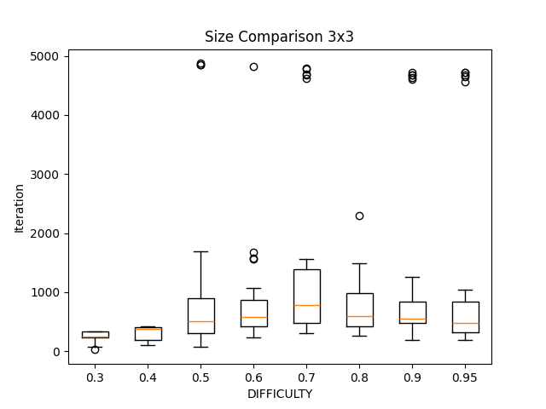
Měření
3x3 s vyladěnými parametry
Graf iterace x ohodnocení
Měřené hodnoty
Velikost:
3x3 – 91 polí
DIFFICULTY
Konstanty
WIDTH = 3
HEIGHT = 3
ITER = 5000
CONFLICT_WITH_TASK_CELL_COST = 10
COOLING_TYPE = Geometric
TEMP_INITIAL = 4
TEMP_LOSS = 0.95
TEMP_REHEAT = 0.5
TEMP_LOW_THR = 0.2
TEST_COUNT = 30

Slide 12
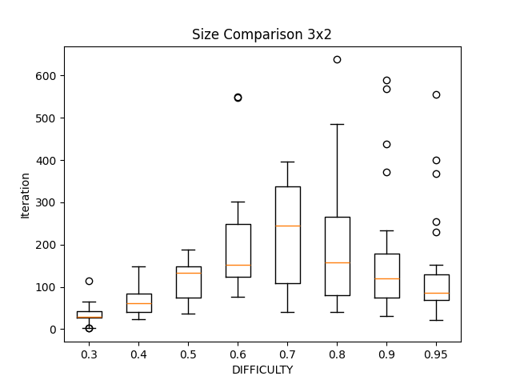
Měření
Graf iterace x ohodnocení
Měřené hodnoty
Velikost:
3x2 - 36
DIFFICULTY
Konstanty
WIDTH = 2
HEIGHT = 3
ITER = 5000
CONFLICT_WITH_TASK_CELL_COST = 10
COOLING_TYPE = Geometric
TEMP_INITIAL = 4
TEMP_LOSS = 0.95
TEMP_REHEAT = 0.5
TEMP_LOW_THR = 0.5
TEST_COUNT = 30

Slide 13
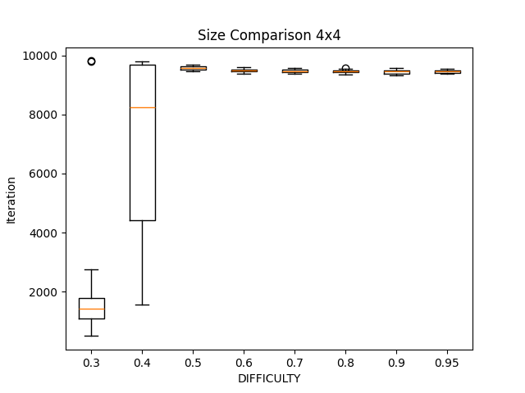
Měření
Graf iterace x ohodnocení
Měřené hodnoty
Velikost:
4x4 – 256 polí
DIFFICULTY
Konstanty
DIFFICULTY = 0.95
WIDTH = 4
HEIGHT = 4
ITER = 10000
CONFLICT_WITH_TASK_CELL_COST = 10
COOLING_TYPE = Linear
TEMP_INITIAL = 2
TEMP_LOSS = 0.2
TEMP_REHEAT = 0.25
TEMP_LOW_THR = 0.2
TEST_COUNT = 30

Slide 14
Děkuji za pozornost!
+----------+----------+----------+----------+
| 11 09 02 | 04 | 07 | 05 |
| 04 06 | 11 | 10 | 03 02 |
| | 09 02 | 04 11 | 07 06 |
| 05 01 | 07 08 | 09 | 04 11 |
+----------+----------+----------+----------+
| 11 09 | 03 08 06 | 12 | 05 02 |
| 03 | 09 10 | 06 | 12 07 |
| 12 06 | 04 07 | 03 05 09 | 08 |
| 08 10 | 05 | 01 | 06 |
+----------+----------+----------+----------+
| 09 10 11 | 08 01 05 | 12 06 | 02 03 04 |
| 07 | 10 03 | 05 01 02 | 08 |
| 01 04 | 12 02 | 08 03 11 | 06 |
| 02 03 | 06 | 09 10 04 | 01 05 12 |
+----------+----------+----------+----------+
4x3: (144)
4x4:(256)
+-------------+-------------+-------------+-------------+
| 04 07 | 14 | 10 | 06 |
| | 01 16 | 15 13 | |
| | 10 | | |
| 16 09 | 08 12 | 07 | |
+-------------+-------------+-------------+-------------+
| | 12 | 04 | 08 01 |
| 10 | 01 02 | 14 15 | |
| 13 | 15 09 | | |
| | | | 12 09 |
+-------------+-------------+-------------+-------------+
| 07 03 | 11 | 16 | 08 |
| 16 | 09 14 | 12 | |
| 13 06 09 | 02 07 | 04 | 15 |
| 12 | 16 15 | 07 13 06 | 01 |
+-------------+-------------+-------------+-------------+
| 06 07 | 09 13 | | 02 05 |
| 09 11 15 | 16 03 | 10 | |
| 02 | 06 | 13 | 15 |
| 12 16 | 04 10 | 06 15 07 | 09 01 |
+-------------+-------------+-------------+-------------+
3x3:(81)
+-------+-------+-------+
| 3 5 4 | 1 9 | 7 2 6 |
| 8 9 | 4 2 | 3 5 |
| 1 6 | 3 | 8 4 9 |
+-------+-------+-------+
| 4 2 5 | 7 | 9 8 |
| 9 3 7 | 2 5 8 | 1 4 |
| 8 | | 5 7 |
+-------+-------+-------+
| 5 9 | 7 2 4 | 6 8 3 |
| 6 | 1 8 | 4 9 2 |
| 8 4 | 3 9 | 5 7 |
+-------+-------+-------+
3x2:(36)
+-----+-----+-----+
| | | 1 |
| 4 | | 5 2 |
| 6 | 1 | |
+-----+-----+-----+
| 2 | | 1 |
| 3 | 4 | |
| | 2 | |
+-----+-----+-----+

